Slide 1
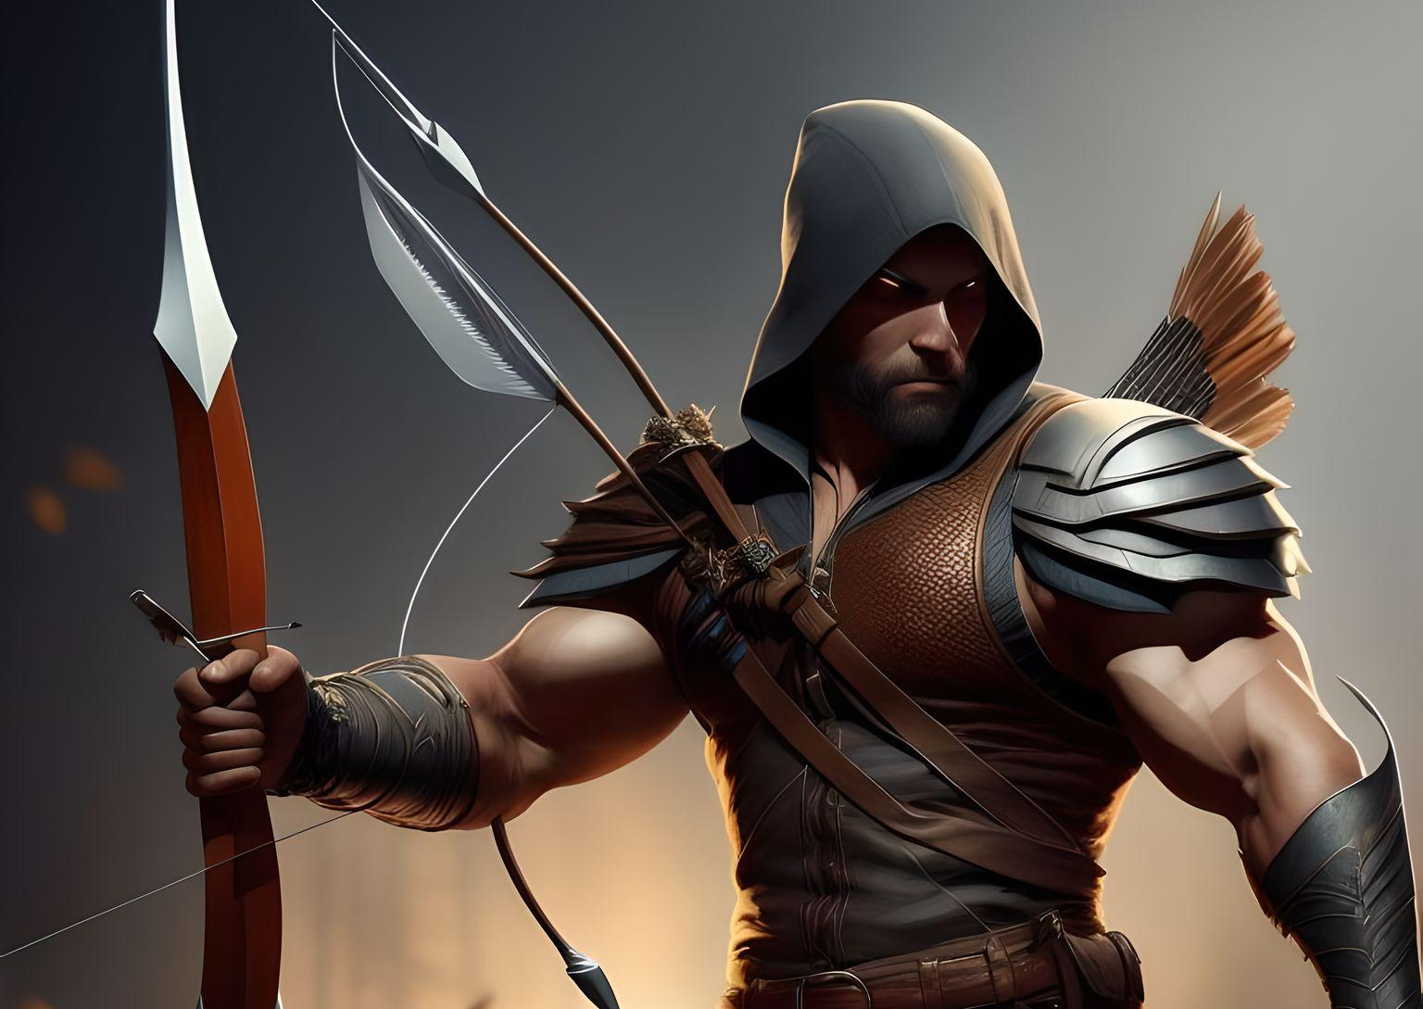
BOW & ARROW ADVENTURE
FINAL PROJECT CHECK-IN 1
NAME: GURWINDER SINGH
STUDENT ID: 200557497

Slide 2
Concept:
Bow and Arrow Adventures is an action-packed mobile game that combines precision aiming and physics-based gameplay. Players take on the role of a skilled archer in a medieval fantasy world, tasked with defeating enemies from afar using a limited supply of arrows. The game offers a challenging yet enjoyable experience as players navigate through diverse environments, encounter various characters, and face off against formidable adversaries.

Slide 3
Objectives:
Create an immersive and visually appealing mobile game that engages players with its unique bow and arrow mechanics.
Challenge players' aiming skills and strategic thinking through precision shooting and physics-based gameplay.
Craft a captivating medieval fantasy world with distinct characters, enemies, and environments.
Provide a rewarding gaming experience with a sense of accomplishment for completing levels and achieving high scores.
Encourage player competition through online leaderboards and social features

Slide 4
Location and Setting:
World:
The game is set in a vividly detailed medieval fantasy realm filled with enchanting landscapes, ancient castles, mystical forests, and treacherous mountain ranges. The world is brought to life through richly illustrated backgrounds and thematic designs, transporting players to a magical era where brave heroes and menacing creatures coexist.

Slide 5
Environments:
Enchanted Forest: A lush forest teeming with magical flora and fauna, hiding secrets and mystical creatures.
Ancient Castle: A foreboding fortress with towering walls and intricate interiors, harboring hidden treasures and formidable foes.
Mystic Mountains: Towering peaks shrouded in mist, where players face extreme weather conditions and encounter mythical creatures.
Dark Caverns: Mysterious underground tunnels filled with challenges, secrets, and perilous traps.

Slide 6
Player Character:
Name: Lorian Stormrider
Appearance:
Rugged, muscular, dark brown hair, piercing blue eyes, hunter's attire.
Abilities:
Master archer with pinpoint accuracy.
Special abilities include slowing time for precise aiming, powerful leaps, and keen environmental awareness.
Background:
Hails from the rugged frontier, skilled hunter, on a mission to protect his homeland from encroaching evil.

Slide 7
Enemies:
Goblins:
Appearance: Short, green, mischievous creatures.
Behavior: Agile and ambush in groups, quick attacks.
Weaknesses: Vulnerable to headshots.
Trolls:
Appearance: Massive, slow, thick hides.
Behavior: Powerful but slow, throw boulders.
Weaknesses: Vulnerable backsides.

Slide 8
Enemies:
3.Dragons:
Appearance: Majestic, fire-breathing, armored scales.
Behavior: Aerial threats with powerful attacks.
Weaknesses: Precise shots at weak points.
4.Dark Sorcerers:
Appearance: Cloaked, mysterious figures with dark magic.
Behavior: Cast spells, summon minions.
Weaknesses: Disrupt their spells with well-timed shots.

Slide 9
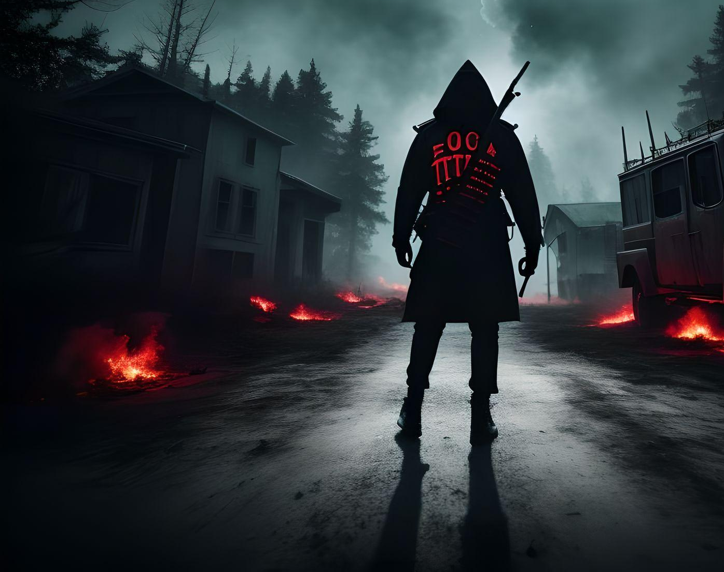
THE END
MDEV1003 PROJECT CHECK-IN 1
GURWINDER SINGH, 200557497

